Slide 1
ML-Optimized Vehicle Routing for Urban Delivery Services
Submitted in the partial fulfillment for the award of the degree of
BACHELOR OF ENGINEERING
IN
Computer Science and Business Systems
Submitted by:
Nikhil Gusain - 23BCB10033
Aryan Dhasmana - 23BCB10081
Simranjit Kaur - 23BCB10084
Vishal Gupta - 23BCB10080
Isha Aggarwal - 23BCB10053
Under the Supervision of:
Dr. Gurwinder Singh(E11253)
Department of AIT-CSE
DISCOVER . LEARN . EMPOWER

Slide 2
Outline
Introduction to Project
Problem Formulation
Objectives of the work
Methodology used
Results and Outputs
Conclusion
Future Scope
References

Slide 3
Introduction to Project
The Vehicle Routing Problem (VRP) is a classic combinatorial optimization challenge in logistics and transportation.
Urban delivery services face increasing complexity due to growing e-commerce demands, traffic congestion, and customer expectations for fast delivery.
This project leverages Machine Learning (ML) techniques combined with traditional optimization methods to create intelligent, adaptive routing solutions.
The hybrid approach aims to predict demand patterns, anticipate traffic conditions, and generate cost-effective delivery routes in real-time.

Slide 4
Problem Formulation
Key Challenges:
Dynamic demand fluctuations across different time periods and locations
Real-time traffic congestion affecting delivery times unpredictably
Multiple constraints including vehicle capacity, time windows, and driver schedules
Traditional VRP solvers struggle with scalability in large urban networks
Need for adaptive solutions that can respond to changing conditions in real-time

Slide 5
Objectives of the Work
Develop ML models to forecast delivery demands and traffic patterns
Hybridize ML predictions with optimization techniques to generate efficient routes
Simulate and compare performance against traditional VRP solvers
Evaluate metrics like cost savings and delivery time reduction
Deploy a web-based prototype for visualization and demonstration

Slide 6
Methodology used
Data Collection: Historical delivery data, traffic patterns, and demand records
ML Models: LSTM/GRU for demand forecasting, Graph Neural Networks for traffic prediction
Optimization: Hybrid approach combining metaheuristics (Genetic Algorithm, ACO) with ML predictions
Simulation: Discrete event simulation for testing routing strategies
Web Prototype: Flask/Django backend with React frontend for visualization

Slide 7
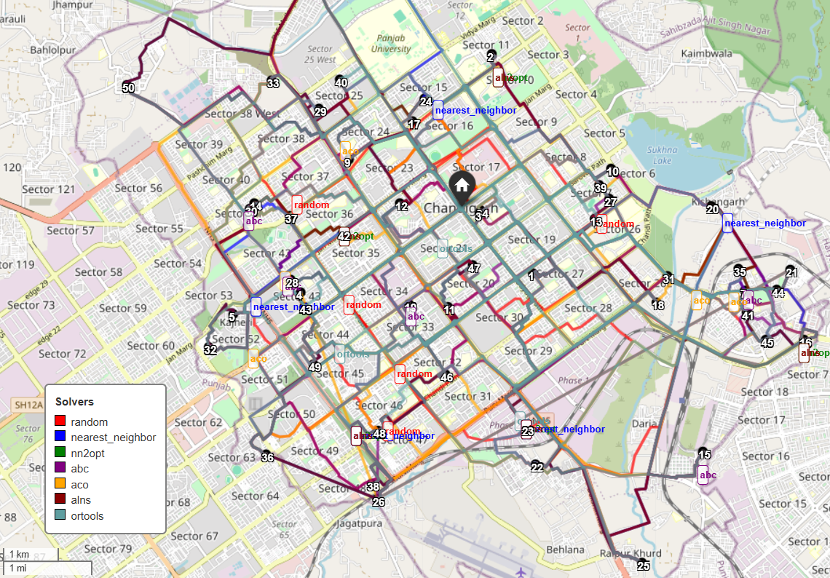
Results and Outputs
Route Optimization: Optimised route distances
Computation Time: Time taken to compute the routes and distances.
Delivery Time Improvement: Analysing the changes between the different algorithms with dynamic demands.
Visualization: Heatmaps and route graphs validated efficiency gains

Slide 8
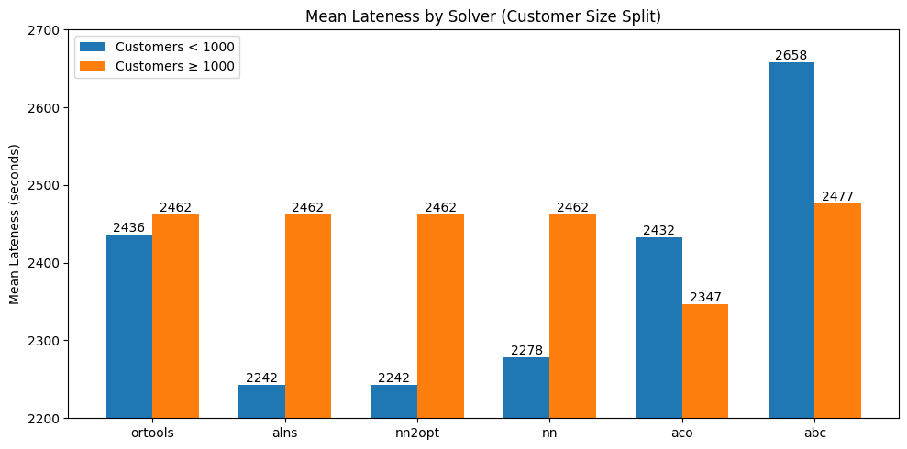
Conclusion
This project demonstrates the effectiveness of integrating ML with traditional optimization for vehicle routing in urban delivery contexts.
The hybrid approach addresses key limitations of conventional VRP solvers by enabling adaptive, data-driven decision making.
Results show significant improvements in cost efficiency and delivery performance metrics.
The web-based prototype provides practical value for real-world deployment and visualization.

Slide 9
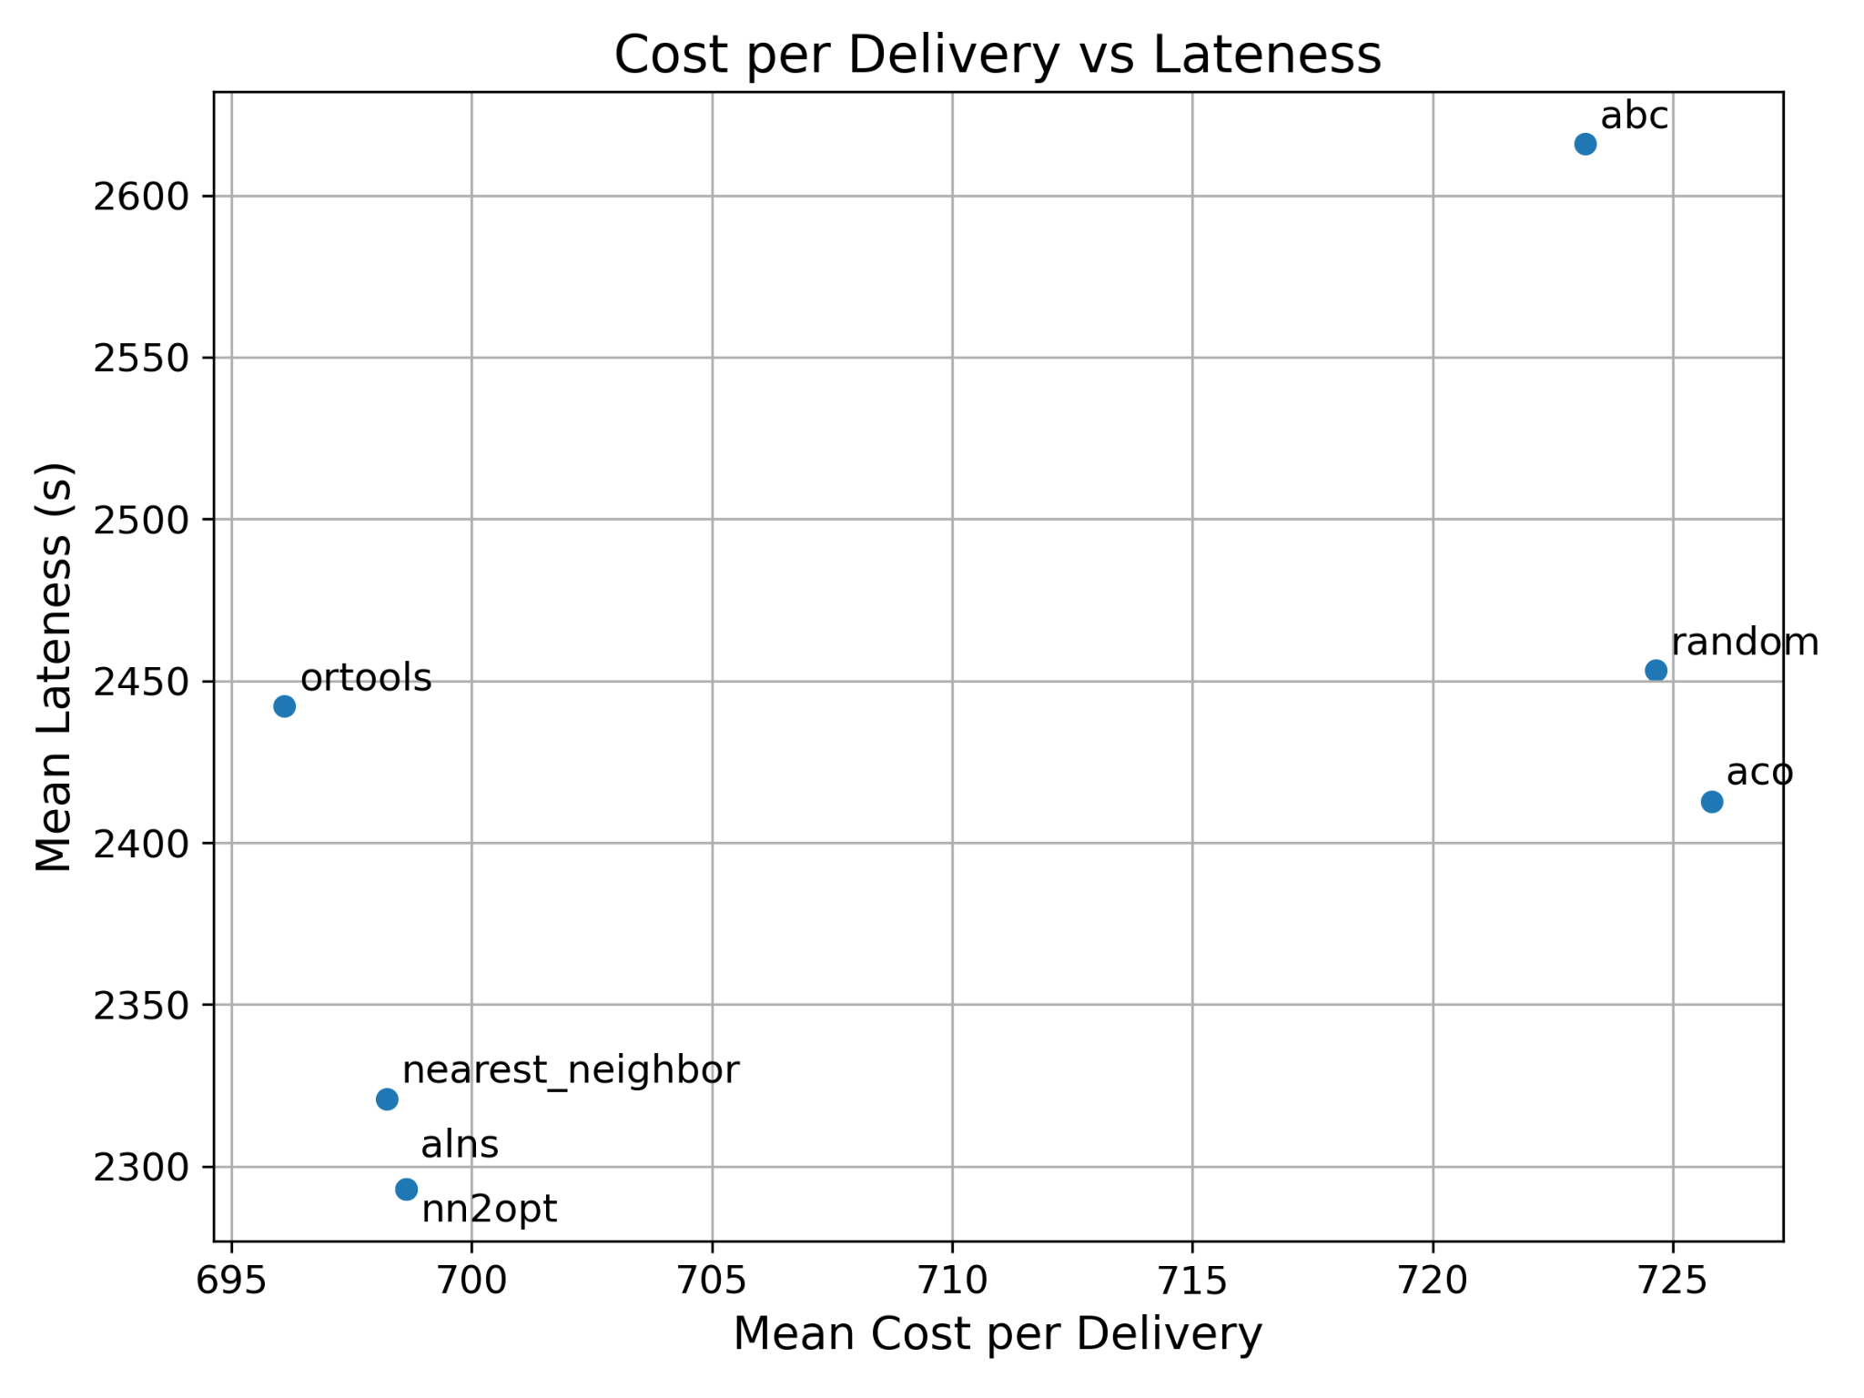
Future Scope
Integration of reinforcement learning for real-time route adaptation
Incorporation of electric vehicle constraints and charging station optimization
Multi-modal transportation integration (drones, bikes, autonomous vehicles)
Expansion to handle dynamic customer requests and crowd-sourced delivery
Carbon footprint optimization for sustainable logistics

Slide 10
References
[1] Toth, P., Vigo, D. (2014). Vehicle Routing: Problems, Methods, and Applications. SIAM.
[2] Nazari, M., et al. (2018). Reinforcement Learning for Solving the Vehicle Routing Problem. NeurIPS.
[3] Kool, W., et al. (2019). Attention, Learn to Solve Routing Problems. ICLR.
[4] Li, J., et al. (2021). Deep Reinforcement Learning for Combinatorial Optimization. IEEE TPAMI.
[5] Google OR-Tools Documentation: https://developers.google.com/optimization

